Slide 1
Welcome to our ‘Back to School’ Curriculum Night!

Slide 2
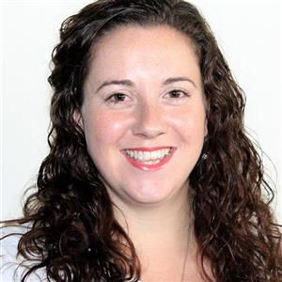
A Little About Us
Erin Coffin
Born in Prince Edward Island, Canada
Bachelor of Arts in History, English, and Theatre Studies from the University of Prince Edward Island
Graduate Diploma in Teaching (Primary)
from the University of Auckland, New Zealand
Lived and taught in South Korea, Venezuela,
and Morocco
Taught Grade 1, KG2, and KG1 previously
2nd year in Dubai and at GWA!
GWA Elementary Swim Coach (C-Squad)
Stage manager for the high school production
Dony Canceran
Ms. Dony will be joining our class after the Eid holiday as our TA for KG2-EC.
Notes:
Talk about you, how great your TA is put a little bit if human aspect it let them know you as a person not just a teacher

Slide 3
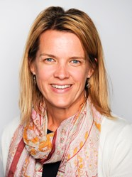
The KG2 team
Ashley Lim &
Roshel
Chantal McLaren
&
Charlene
Hannah Williams &
Florence
Amy Bossler &
Michelle
Erin Coffin
&
Dony
Nicola Wilcox
&
Edna
Cheryl Murree
Assistant Early
Childhood Principal
Notes:
Our amazing team. We collaborate, share ideas. 7 heads better then 1. Darlene EC Cordinator. Over half of the KG2 team have EC age children. Provide many opportunities for children to play across classrooms allowing tor old and new friendships

Slide 4
How We Know What Students Have Learned
Observations
Prior knowledge to drive inquiry
Assessment
Thinking process rather than product
Portfolios – Digital – Seesaw app
Student Led Conferences
Authentic
Inform teaching
Continuous
“you can control the environment but you can't control the child.” - Froebel
Notes:
We find out what a child knows and then move them forward we don’t do whole class teaching so we can extend each and every child to reach their potential
Portfolios why work not sent home? Shows progression you are welcome to look at them at any time throughout the year.
SLC – 3rd quarter a time for your to child to show what they know is an amazing day
Within early childhood, assessment should rely heavily on the results of observations and descriptive data and this is what we should use to influence our teaching. I believe the main reason for assessments should be to inform our teaching and not as a means of labeling a child.

Slide 5
Approach to Education
Inquiry based
Challenged according to what students are ready to learn next
Differentiation, activity based, small group and individualised learning
Play Based (outdoor discovery)
Integrated technology
Benefits of learning through play
Creativity
Fine and Gross motor skills
Problem Solving
Self esteem
Master new skills
Develop language
Making Connections
Social
Persistence and concentration
Notes:
Each child is a unique person with an individual pattern and timing of growth, as well as individual personality, temperament, learning style, and background. All children have their own strengths, needs, and interests which resonates with Dewey and his belief that all children do not arrive at school as blank slates but that each child has his own instincts and tendencies. Even though a child might be the same chronological age, it is not an indication of their developmental age. Recognize and teach to their learning styles and preferences
We teach through play
Montessorio & Reggio 5 sense teach using all the senses
Dewey's philosophy is that all "experiences should be real" and we should be taking advantage of teachable moments
Children need to be set up for success and be able to learn from failures in order to move forward and to gain a deeper understanding. Confronted by repeated failure, most children will simply stop trying.

Slide 6
The Year Ahead Academically
Unit of
Inquiry
Arabic Studies
PE
ICT
Library
Maths
Social
Stars
Art
Language
Swimming
Notes:
Everything is embedded through out the units.
We regularly review our curriculum to make sure we cover all essential elements
PYP scope and sequence

Slide 7
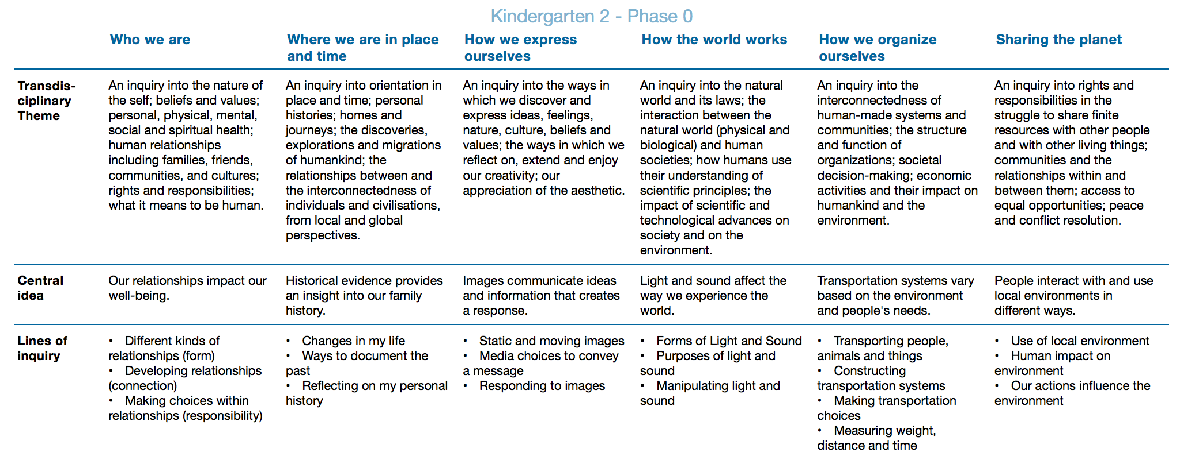
The Year Ahead Academically
Units of Inquiry

Slide 8
Math
Language
Number
Sorting
Graphing
Time (and calendar)
Measurement
Shape – 3D and 2D
Patterning
Fractions
Skip counting
Addition and subtraction
Letter names and sounds
Phonics groups
Reading strategies
Sight words (Heart words)
Fine motor skills
Letter formation
Conventions of text
Speaking
Listening
Modeled
Guided
Shared
Independent
Notes:
Just some of the main areas we cover – see curriculum expectations for more details posted on website

Slide 9
Support learning at home
What we are encouraging at school and how you can support this at home…
Reinforce Learner Profile
Practising lower case letters NOT CAPITALS!
Focus on letter sounds (what is the sound/name) https://www.youtube.com/watch?v=5J2Ddf_0Om8
Independence – unpacking their own bags, water, and lunches in the mornings, carrying own bags
Homework – reading and heart words
Heart words
Reading
Inquiry
Independence
“Parents are the child's first teacher“ – Reggio Emilia
Independence
Independence
Play
Notes:
Let your child be a risk taker – try new things, give things a go that they haven’t done before
Thinker – solve problems, build things be creative
Inquirer – ask questions, find out answers
Well-balanced – let them have fun it shouldn’t be all work and no play
At the end of a busy day, it is also essential for children to have time to relax, rest and have fun with family and friends. It is also important for children to have time where they have to make decisions about what they are going to do in their free time. This helps them to become independent, creative and confident people
Home work
When your child is ready: books 1 in 1 out policy 2 levels below celebrate their reading give confidence sight words. Homelinks give you an idea of what your child needs to work on as well as links to ipad apps and computer games that can be used to consolidate these skills - occasional inquiry homework most of all let them play!

Slide 10
Class Rewards and Behaviour
Star of the week
to reinforce IB learner profile
Lenny the Lobster
Scouts
students will monitor their peers behaviour
3 Essential Agreements:
Show respect
Make good decisions
Solve problems

Slide 11
Celebrating a Birthday
Celebration in the last 20 minutes of the day or on a Thursday if your child’s birthday falls on the weekend
Share a healthy treat with the class and the parents are more than welcome to be there to celebrate with us.
Healthy snack – i.e. fruit kebabs. NO whole class cupcakes/cookies etc. Please save this for your celebration at home.

Slide 12
Daily Reminders…
School drop off is 8:00 - 8:15am
Lunches:
Healthy lunches
Spoons and forks packed from home
Label your child’s lunch box
Only hot food occasionally (it is not encouraged)
Nut free school
Please name ALL uniform and accessories
Send a water bottle to school daily (labeled)
No toys from home to come to school
Please only return library books in the library folders on the day of the lesson
Class readers will be changed on a Sunday

Slide 13
Donations gratefully received…
Junk modeling materials (boxes, yoghurt pots, bottles, egg boxes etc.)
Please ensure these are clean and dry before sending to school
Glass jars with lids
Collage materials (cloth, pebbles, shells, art materials etc.)
Plants
Unwanted sheets, beddings, cushions etc.
Any other resources ☺

Slide 14
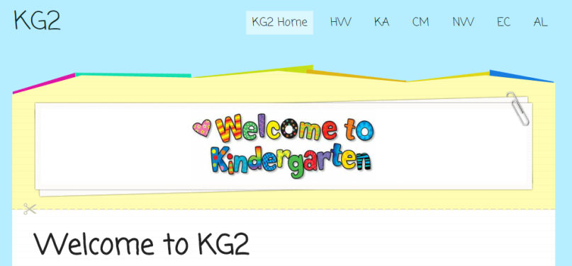
Communication
How can we work together?
Many ways to be in touch including face-to-face, email etc.
Ask questions as they come up, open door policy
Please regularly check the KG2 website- updated weekly
Let me show you!
Sign up to the email alert for weebly updates!!
www.kgtwogwa.weebly.com
e.coffin_gwa@gemsedu.com
Notes:
Be open to anything million ways you can contact me check weebly all the time this is our main place for providing information

Slide 15
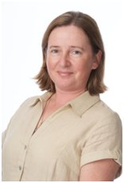
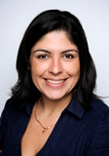
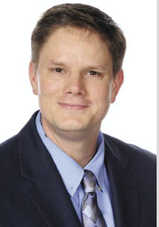
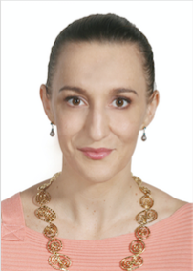
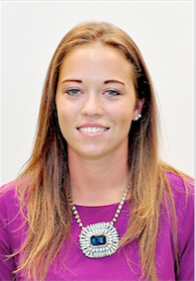
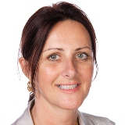
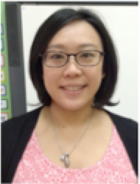
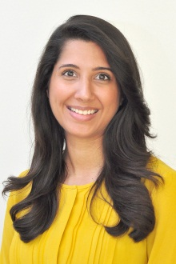
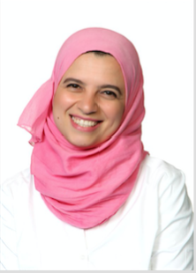
Specialist teachers
Margaret Sikora
Music
Beatriz Arbelaez
ICT
Neal Clark
ICT
Leanne Collins
Visual Arts
Dean Winders
P.E.
Lottie Lucas
Swimming
Anita Henry
Library
Suzie Shih
Counselor and
Social Stars Teacher
Zahra Hadi
EAL
Samah Koura
Arab Studies Teacher
Notes:
The whole team that will be working with your child to ensure a successful year

Slide 16
Specialist Locations
PE & Swimming …………………...…Reception Area
Counseling Team……………..Library
ICT Team………………..……Library
Learning Support Team………Library
English as an Additional Language (EAL) Team…….Library
Music Team……………………………………..Library
Arabic Classrooms…………………………..….Level 2
Library Team……………………………………Library
Art Team…………………………………..…….Library
Coffee and tea served on first floor open area

Slide 17
Thank you for coming.
Questions?
Notes:
If you don’t know the answer you will find it out and let them know be honest and open

